Slide 1
Manage Final Data Documentation
Data and Analysis Delivery
Process Documentation

Slide 2

Final Data Documentation: Overview
Notes about this course:
This slide deck is in support of the procedural training “Manage Final Data Documentation”.
This module will address the common deliverables, as part of regulatory submission and final data documentation and the related requirements. Commonly referred to as the case report tabulation (CRT) package, it provides a complete and accurate description of the data.
For the optimal training experience, please view this training deck in “Slide Show” mode
After this course, you will be able to:
Articulate the purpose and contents of the CRT
List the contributing roles enabling study data documentation
List the 8 deliverables that constitute a CRT package
Describe aspects of each of the 8 deliverables
Know the difference between SDTM and ADaM CRTs
Navigate to additional support regarding study data documentation

Slide 3
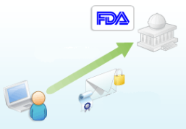

The Case Report Tabulations (CRT) Package is Final Data Documentation
The Submission
“Big Picture”:
This is worth repeating!
Case Report Tabulations are the standard package for submitting datasets and their metadata
The CRT provides a complete and accurate description of the data via a collection of well-defined and standardized metadata
Submissions Package including the CRT
What?
The CRT is a portion of the submissions package delivered to the FDA for data review
It is the standard package for sharing datasets and their metadata for industry usage
It provides a complete and accurate description of the data via a collection of well-defined and standardized metadata
Who?
It is used by the reviewers at the regulatory authority
It is used by external independent researchers who request it through Lilly’s Data Transparency Policy
It is used by other Lilly researchers for data mining, integration, etc.
Why?
It is needed to facilitate the review of a submission and understanding of the data while providing the following benefits:
Allows easier navigation of the data using bookmarks and links throughout the package
Provides consistency through the use of specifications from the FDA and CDISC
Speeds the review process by reducing the time needed to become familiar with the data

Slide 4

Strategic Changes to CRT delivery
A Change in Purpose
Previously: CRT packages were created only when needed for a submission
Now: CRTs are also used to support Data Transparency and internal data mining needs
Why: 1) In January, 2014 Lilly publicly announced a commitment to share clinical study data with external researchers. The CRT package is a key deliverable to researchers because it helps them understand the data and minimizes questions back to Lilly. 2) Lilly also uses clinical study data to data mine long after studies are completed to help answer customer and/or research questions.
A Change in Timing
Previously: CRT packages were created just in time for submission
Now: Create study data documentation during the study and finalized at final data base lock (or at both primary and final if primary data is used for submission)
Why: Resources with a familiarity of the study are available to ensure that the CRT components are complete and accurate. Whereas, waiting until the CRT is ready for a submission could require a different resource with less knowledge of the study, to create it, which could increase effort and reduce quality. This new timing will reduce the risk in delaying deliverables as well as allows for real time delivery of the CRT package if required.

Slide 5
What Does a CRT Include?
CRT Components:
Annotated CRFs
(SDTM CRT)
Datasets (SAS transport files) (SDTM & ADaM)
Data Reviewer’s Guide (SDRG or ADRG)
Data Define Document (define.xml) (SDTM & ADaM)
TFL & ADaM Dataset Creation Programs
(ADaM CRT)
You can view the SDTM and ADaM CRTs as each having four parts, which are the four deliverables that are produced when the Manage Final Data Documentation procedural training at Lilly is executed
These four deliverables are the FOCUS of this overview module
Later on this presentation we will examine each of the four deliverables in detail
But first we need to discuss the roles involved in study data documentation at Lilly

Slide 6

Who is Involved with the Creation and Review of Study Data Documentation?
Several roles contribute to creating the study data documentation in support of completing the CRT.
Responsibility for managing final study data documentation deliverables is dependent on a study’s status.
Roles providing input may include but are not limited to the following:
Clinical Data Associate (CDA)
SDTM/ADaM Consultant
Submission Coordinator/ Consultant
SDTM/ADaM Programmer
Final Study Data Documentation
Stat Analyst
PK Data Delivery Associate (for PK datasets)

Slide 7
RACI Definitions
Responsible - Those who do the work to achieve the task. There is at least one role with a participation type of responsible, although others can be delegated to assist in the work required.
Accountable - The one ultimately answerable for the correct and thorough completion of the deliverable or task, and the one who delegates the work to those responsible. In other words, an accountable must sign off (approve) work that responsible provides. There must be only one accountable specified for each task or deliverable.
Consulted – Those whose opinions are sought, typically subject matter experts; and with whom there is two-way communication.
Informed - Those who are kept up-to-date on progress, often only on completion of the task or deliverable; and with whom there is just one-way communication.

Slide 8
Overall Management of Study Data Documentation: Who is Accountable for GSS owned SDTM/ADaM creation?
Roles for managing final study data documentation may differ based on individual study needs, but here are some common roles & responsibilities based on the latest RACI Model:
R = Responsible, A = Accountable, C = Consult, I = Inform
Action | SDTM/ ADaM Programmer | Stat/SA | Sub. Consultant | SDTM/ ADaM Study Consult.
Creates SDTM/ADaM transport files of datasets, annotated CRFs, SDRG/ADRG and define documents. | R/A | A |  | C*
Conducts review & ensures finalization of annotated CRFs, transport files, SDRG/ADRG, define documents, and analysis programs if applicable. | A | R/A |  | C*
Complete Submission Readiness Review of CRT package and update submission tracker with finalization date. |  | A | R
Ensures all SDTM/ADaM CRT components are stored in the correct secure location SDD/ AWE/ CLUWE to be pulled into the eCTD. |  | R/A | I
*SDTM and/or ADaM Consultants may be Responsible for these Actions if the SDTM creation is owned by DSS TPO, otherwise the SDTM/ADaM Consultants will “consult”.
Notes:
NOTE: The CDA’s role is to inform the submission team of an upcoming CRT work not related to a submission that will require submission team review.
Donna
Some additional explanation the work is done by the SDTM/ADaM Programmer, The CDA ensures in consultation the work is done with the SDTM/ADaM Consultant, is done appropriately
Changes 4/27/2015 – “Responsibility” wording changed to “Accountability”
Should we break out into two slides to discuss Legacy and CDFM separately?
Need additional explanation on CDA responsibility with SDTM and ADaM deliverables
Need to define responsible party for SDTM/ ADaM. Doer of the work is going to be TPO or SA.

Slide 9
Remember the Components of a CRT?
Annotated CRFs (SDTM CRT) (observed data package only)
TFL & ADaM Dataset Creation Programs
(ADaM CRT)
SAS Transport Files (SDTM & ADaM)
Data Define document (SDTM & ADaM)
Data Reviewer’s Guide (SDRG & ADRG)

Slide 10

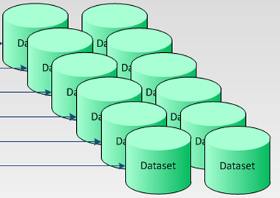
SAS Dataset Transport Files: What should I know?
Study data must be converted into SAS transport files for submission.
The transport files must align with/match the final production data used in the analysis
SAS dataset transport files should be:
in a platform independent format of the data provided
converted from each dataset with a file extension of .xpt
no larger than 5GB or (if greater than 5GB, can be divided into more than 1 file, as per FDA)
un-compressed
structured as flat files:
Rows represent observations
Columns represent variables
linked to, by external hyperlinks in the define.xml document
created by the SDTM or ADaM Programmer
order of variables in transport need to align with the order of variables in the define.xml
SAS Trans-port Files

Slide 11

CRT Components
Annotated CRFs (SDTM CRT) (observed data package only)
TFL & ADaM Dataset Creation Programs
(ADaM CRT)
SAS Transport Files (SDTM & ADaM)
Data Define document (SDTM & ADaM)
Data Reviewer’s Guide (SDRG & ADRG)

Slide 12
Final (annotated to SDTM) Annotated Case Report Forms (aCRFs)
Final Annotated CRFs is a package that contains a copy of each unique CRF from the collection system with SDTM domains/variables noted for each collected item. The aCRF package could also include ePRO/eCOA annotations, if the data is included in SDTM.
The annotations indicate where each collected piece of data resides in the SDTM datasets
What?
Who?
The Final Annotated CRFs are created by the SDTM Programmer
A statistical representative or SDTM Consultant SME for the study may consult as needed
Anno-tated CRFs

Slide 13
Characteristics of the aCRF
Maps the data collection fields (DEDs at Lilly) used to the corresponding variables within the SDTM dataset
Only needs the first occurrence of the page annotated if Lilly is submitting the entire CRF
If more than one domain exists on a page as each domain annotation, and all of its variables, should be color-coded
Should be provided as a PDF file. Document name should abide by the following format: acrf.pdf
Must follow this naming convention!
Must be bookmarked to 2 levels: by time point (i.e. visit) & topic (i.e. domain)"
Can have a table of contents included, but it is not required
Includes only unique case report forms
Anno-tated CRFs

Slide 14
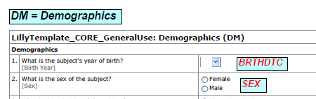

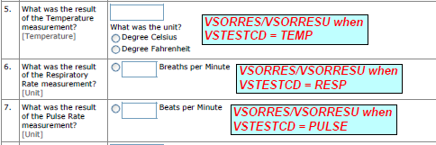
Final Annotated CRFs – Example of acrf.pdf
Note: Text in Black represents the domain and text in Red represents the variable location in the domain
Guidelines for annotated CRFs can be found in the SDTM - Metadata Submission Guidelines document on the CDISC website.
Anno-tated CRFs

Slide 15
CRT Components
Annotated CRFs (SDTM CRT) (observed data package only)
TFL & ADaM Dataset Creation Programs
(ADaM CRT)
SAS Transport Files (SDTM & ADaM)
Data Define document (SDTM & ADaM)
Data Reviewer’s Guide (SDRG & ADRG)

Slide 16
The Data Definition Document (define.xml)
What is its purpose?
Who creates it?
Describes the content and structure of the data for clinical trial studies including PK/PD studies
The SDTM or ADaM Programmer is responsible for the creation of the Data Definition Document
Lists the SAS Transport Files/datasets with a detailed description of the contents of each dataset (including value level metadata and code lists)
The PK DAT team is responsible for the creation of the DDD for PK datasets.
Data Define document
The statistical representative, SDTM or ADaM Consultant, and/or Submission Consultant may be consulted for input
A reviewer at the regulatory authority will typically start their review with the Define document

Slide 17
Characteristics of the Data Definition Document, or Define.xml
A type of data definition that utilizes metadata to describe the format and content of the submitted datasets
XML (Extensible Markup Language) is a data structure that can be rendered and navigated in a web browser by using a style sheet
CDISC/ FDA requirement and governed by its guidelines
http://www.fda.gov/downloads/ForIndustry/DataStandards/StudyDataStandards/UCM384744.pdf
What?
Why?
Provides a table of contents for users of the datasets
Allows for data sharing between applications
Provides links to navigate the different components of the CRT package
Where?
Is included in both the SDTM and ADaM CRT packages
Data Define document

Slide 18
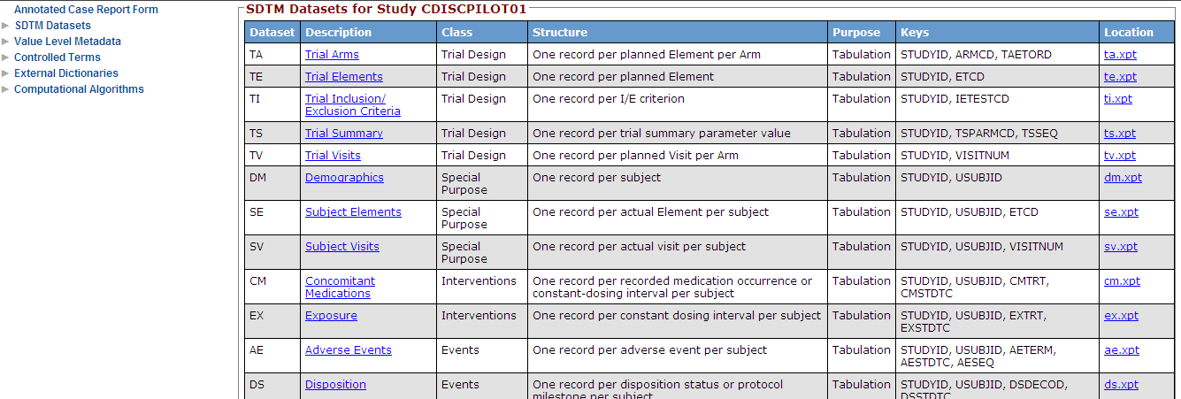
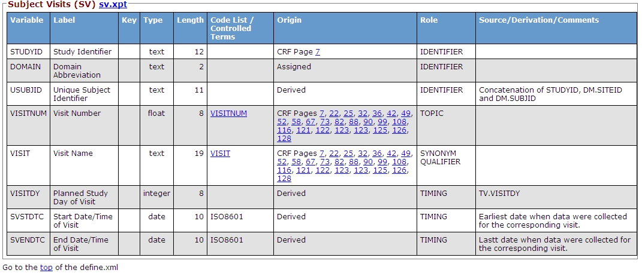
What does the Define.xml look like?
Define.xml Example:
These are bookmarks for the review’s navigation.
These are required in the define.xml.
The define.xml is generated by P21E at Lilly. Refer to the CDER/FDA Guidance – “Metadata Submissions Guidelines”
Data Define document
To view a full define.xml example click here

Slide 19
CRT Components
Annotated CRFs (SDTM CRT) (observed data package only)
TFL & ADaM Dataset Creation Programs
(ADaM CRT)
SAS Transport Files (SDTM & ADaM)
Data Define document (SDTM & ADaM)
Data Reviewer’s Guide (SDRG & ADRG)

Slide 20
Study Data Reviewer’s Guides: SDRG and ADRG
What additional information do these documents provide?
Identification of the standards and dictionaries that were utilized
Details regarding domains, variables or metadata that were “sponsor defined”
Description of any data and/or CDISC conformance issues
Who is responsible?
The SDTM Programmer is responsible for the creation of the SDRG and the ADaM Programmer is responsible for the creation of the ADRG
A statistical representative reviews and may consult with the CDA, Submission Consultant and SDTM/ADaM Consultants as needed
Description of the study design
Data Reviewer’s Guide

Slide 21
Study Data Review’s Guide (SDRG)
To provide a single document to assist Regulatory Reviewers with any special considerations or directions to assist with the review of the submitted data.
Because the define.XML does not adequately document/explain the following:
SDTM mapping decisions
Sponsor-defined domains
Sponsor-defined controlled terminology
Sponsor extensions to CDISC controlled terminology
Therefore, a standardized data guide helps address the documentation gap
Why is it needed?
Four main sections and one optional appendices:
Introduction
Protocol Description
Subject Data Descriptions
Data Conformance Summary
Appendix I: Inclusion/Exclusion Criteria
What does it contain?
Data Reviewer’s Guide
Where is it located within the CRT?
It is linked to the SDTM Define.xml
How do I get help creating it?
The SDRG@Lilly template is available
Click on the link provided here: SDRG template

Slide 22
Analysis Data Reviewer’s Guide (ADRG)
Provides reviewers with additional contents for ADaM datasets
It Is linked to, from the ADaM Define.xml
There are eight sections.
Introduction
Protocol Description
Analysis Considerations Related to Multiple Analysis Datasets
Analysis Data Creation and Processing Issues
Analysis Dataset Descriptions
Data Conformance Summary
Submissions of Programs
Appendix (Optional)
Here is the Link for Lilly ADRG Template
http://lillynetcollaboration.global.lilly.com/sites/CDFTProcess/Business%20Document%20Repository/ADRG%20@Lilly%20Template.docx
The ADRG template provides an orientation to the submitted data in a consistent and usable format

Slide 23

Putting It All Together
We have learned about the various deliverables that can be part of the CRT package
So what makes up a SDTM CRT vs. an ADaM CRT?

Slide 24
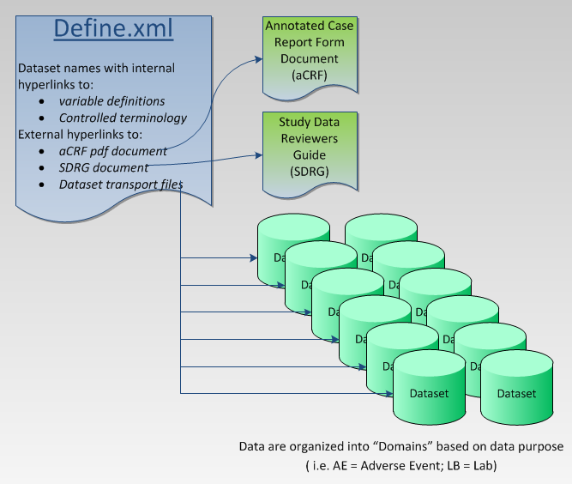
SDTM CRT Package
An SDTM CRT Package contains:
Define.xml
Annotated CRF (acrf.pdf)
SAS Transport Files (.xpt)
Study Data Reviewer’s Guide (SDRG.pdf)

Slide 25
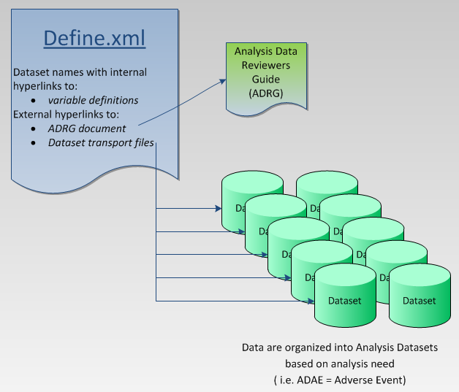
ADaM CRT Package
An ADaM CRT Package contains:
Define.xml
SAS Transport Files (.xpt)
Analysis Data Reviewer’s Guide (ADRG.pdf)
Analysis dataset & TFL programs
Note: Annotated CRFs are not required for the ADaM CRT package

Slide 26

Additional Resources
Internal Resources
For CRT Preparation Questions
Submission Data Delivery Team
For Broader Submissions Questions
Submission and Approval Expert Network’s (SAEN)
Consists of more than 50 cross-functional and cross-geographical experts
External Resources
CDISC - www.cdisc.org
FDA – www.fda.gov
Study Data Specifications
Study Data Technical Conformance Guide
Define.xml - choose“Define-XML” under “Standards”
Metadata Submission Guidelines
For SDTM define.xml questions: Donna Sattler
For SDRG questions: Max Williams
For ADRG questions: Kiran Padhiar
For aCRF questions: Annette Travalent
For ADaM define.xml questions: Kiran Padhiar

Slide 27

Learning Summary for Study Data Documentation
In this training overview you learned:
Why the CRT package is important to reviewers at a regulatory agency and to internal and external researchers using the data
What roles contribute to the management, creation and review of the study documentation components
What components make up the CRT and the similarities and differences of the SDTM and ADaM CRT packages
Where to go for additional support regarding study data documentation

